Slide 1

Methods and applications for multi-study learning with genomics data
W. Evan Johnson, PhD
Professor of Medicine, Division of Infectious Disease
Director, Center for Data Science
Rutgers University – New Jersey Medical School

Slide 2







Slide 3
Batch Effects in Genomic Data
Batch Effect: Non-biological variation due to differences in batches of data that confound the relationships between covariates of interest.
Caused by differences:
Data profiling/generation platform
Lab protocol or experimenter
Time of day or hybridization
Atmospheric ozone level (Rhodes et al. 2004)

Slide 4
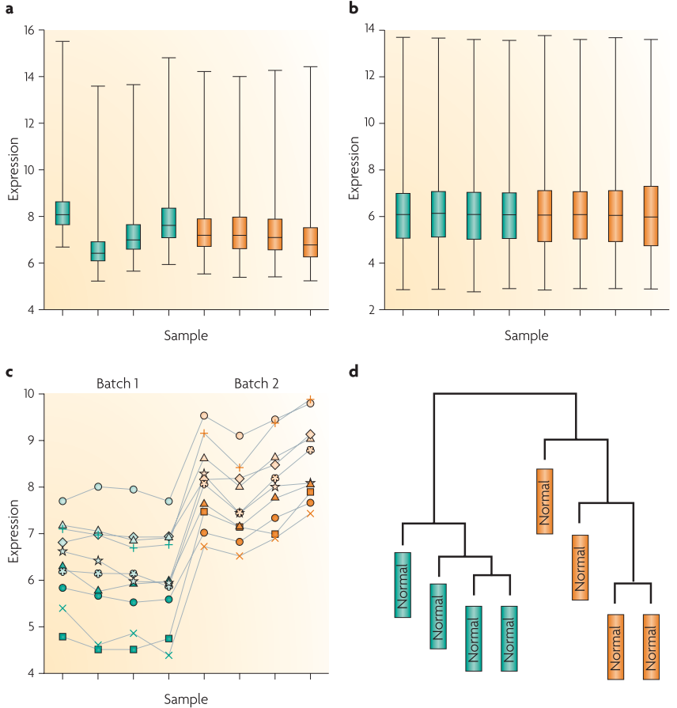
Batch Effect Example: bladder cancer
Batch effect cannot be fully corrected using standard normalization methods
Overall adjustment does not remove all technical variation
Genes or cell types impacted differently by batch
Coverage differences
Library composition batch effect
Leek, Jeffrey T., et al. "Tackling the widespread and critical impact of batch effects in high-throughput data." Nature Reviews Genetics 2011
Notes:
Another thing worth clarifying and emphasizing about batch effect is that not all batch effect can be adjusted by normalization
Coverage – total
Library composition is basically how much each gene

Slide 5
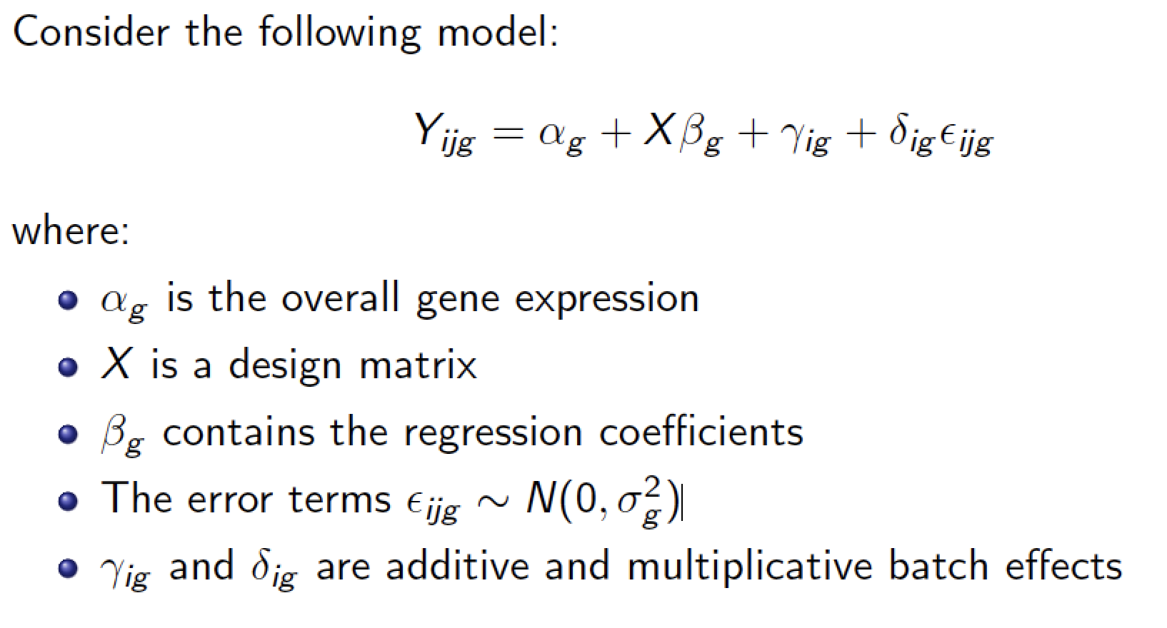
Combining Batches (ComBat) of Genomic Data
Johnson, et al. "Adjusting batch effects in microarray expression data using empirical Bayes methods." Biostatistics, 2007

Slide 6
ComBat-Seq algorithm
Data
Step 1
Model
Fit Negative Binomial regression model
Step 2
Adjust
Compute "batch-free" distribution
Quantile adjustment
Obtain batch effect estimates
Count matrix
Zhang, et al. "ComBat-seq: batch effect adjustment for RNA-seq count data." NAR Genomics Bioinformatics., 2020
Yuqing Zhang
Notes:
we propose to address all these issue
2 steps – model & adjust

Slide 7
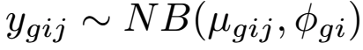
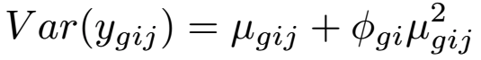
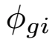
ComBat-Seq algorithm: Model
Negative Binomial regression
Gene-wise model: for a certain gene g, count in sample j from batch i
Average level for gene g (in “negative” samples)
Decompose scaled counts into 3 components
Biological condition of sample j
Mean batch effect
Variance batch effect
Zhang, et al. "ComBat-seq: batch effect adjustment for RNA-seq count data." NAR Genomics Bioinformatics., 2020
Yuqing Zhang
Notes:
In the scaled matrix, we decompose the values into 3 components – 3 terms in the equation
Background
Biological condition – X is indicator for the condition
Batch effect affecting the mean
Aside from these 3 components, the flexibility for variance batch effect is given by

Slide 8
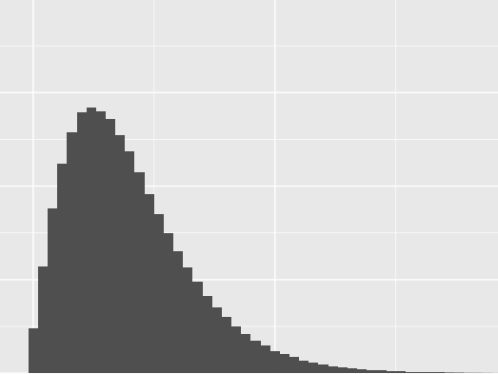
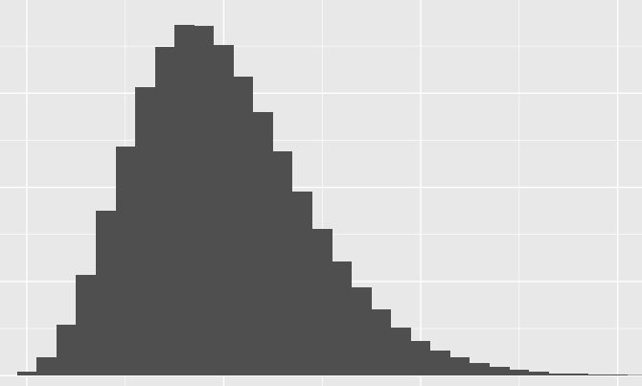
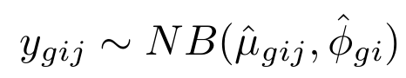
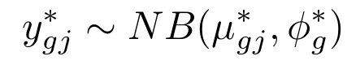
ComBat-Seq algorithm: Adjust
Adjust the data
Original count matrix
Adjusted count matrix
 | S 1 | S 2
G 1 | 14 | 12
G 2 | 0 | 0
G 3 | 112 | 11
…
 | S 1 | S 2
G 1 | 9 | 8
G 2 | 0 | 0
G 3 | 60 | 47
…
Empirical distribution of original counts:
Batch-free distribution for adjusted counts:
Yuqing Zhang
12
8
Zhang, et al. "ComBat-seq: batch effect adjustment for RNA-seq count data." NAR Genomics Bioinformatics., 2020
Notes:
Mapping from NB to NB - still integers

Slide 9


Slide 10
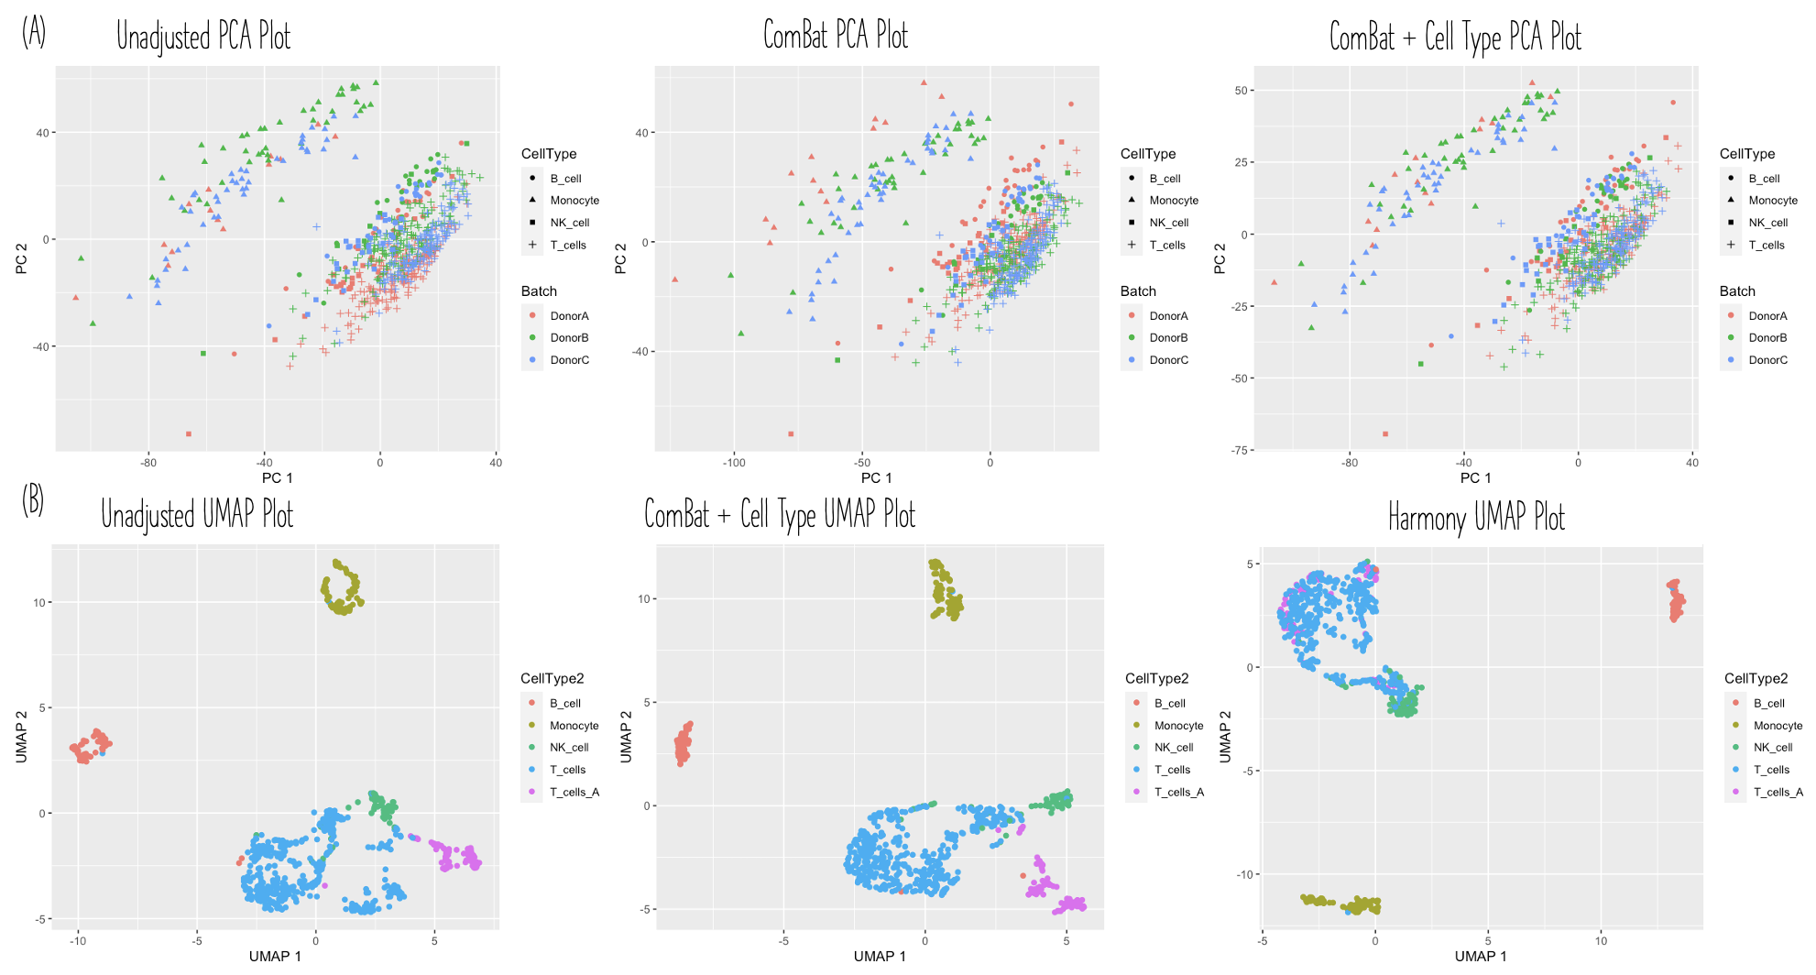
ComBat-Seq for single cell data

Slide 11
Raw Data Adjustment: Spike in Accuracy
ComBat-Seq for single cell data
Method | Sensitivity | Specificity
Unadjusted data | 0.319 | 0.869
ComBat-Seq | 0.782 | 0.876
ComBat-Cell-Seq | 0.841 | 0.849
ScMerge | 0.718 | 0.782

Slide 12
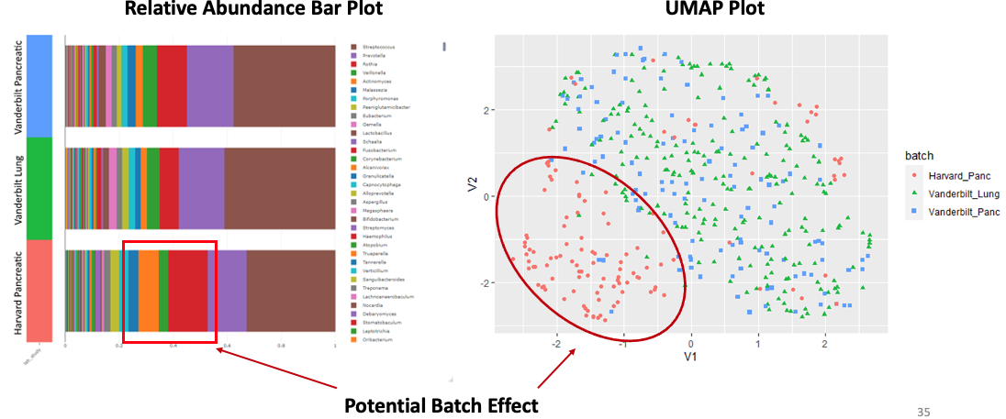

GEE Models for Microbiome Analysis
Howard Fan

Slide 13

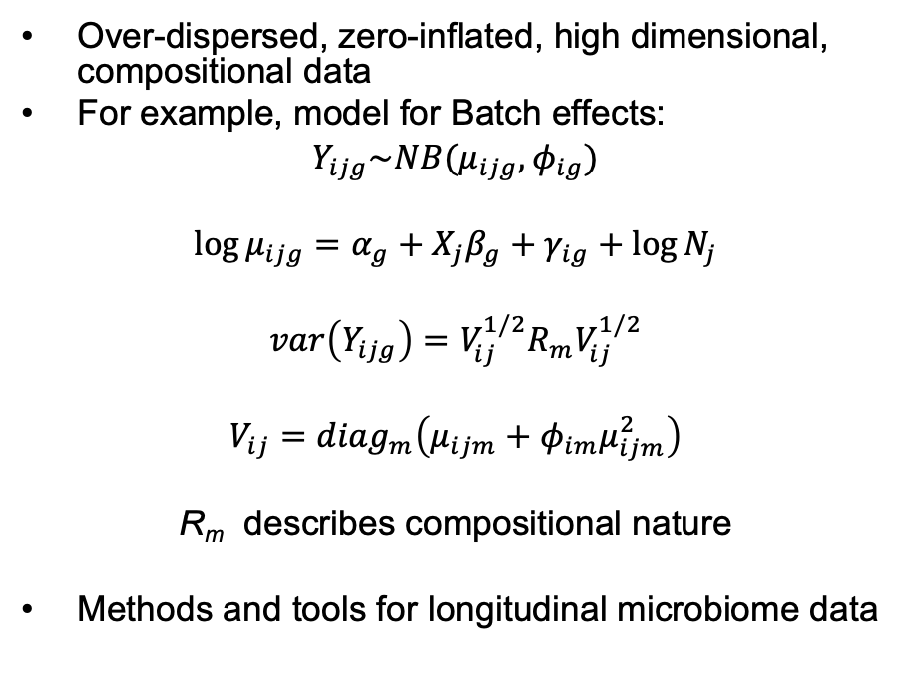
GEE Models for Microbiome Analysis
Over-dispersed, zero-inflated, high dimensional, compositional data
For example, model for Batch effects:
$Y_{ijg}\sim NB(μ_{ijg},φ_{ig})$
$$\log{μ_{ijg}}=α_{g}+X_{j}β_{g}+γ_{ig}+\log{N_{j}}$$
$$var\left(Y_{ijg}\right)=V_{ij}^{1/2}R_{m}V_{ij}^{1/2}$$
$$V_{ij}={diag}_{m}\left(μ_{ijm}+φ_{im}μ_{ijm}^{2}\right)$$
R_{m} describes compositional nature
Methods and tools for longitudinal microbiome data
Yuqing Zhang
Brie Odom
Howard Fan
Lucas Schiffer

Slide 14
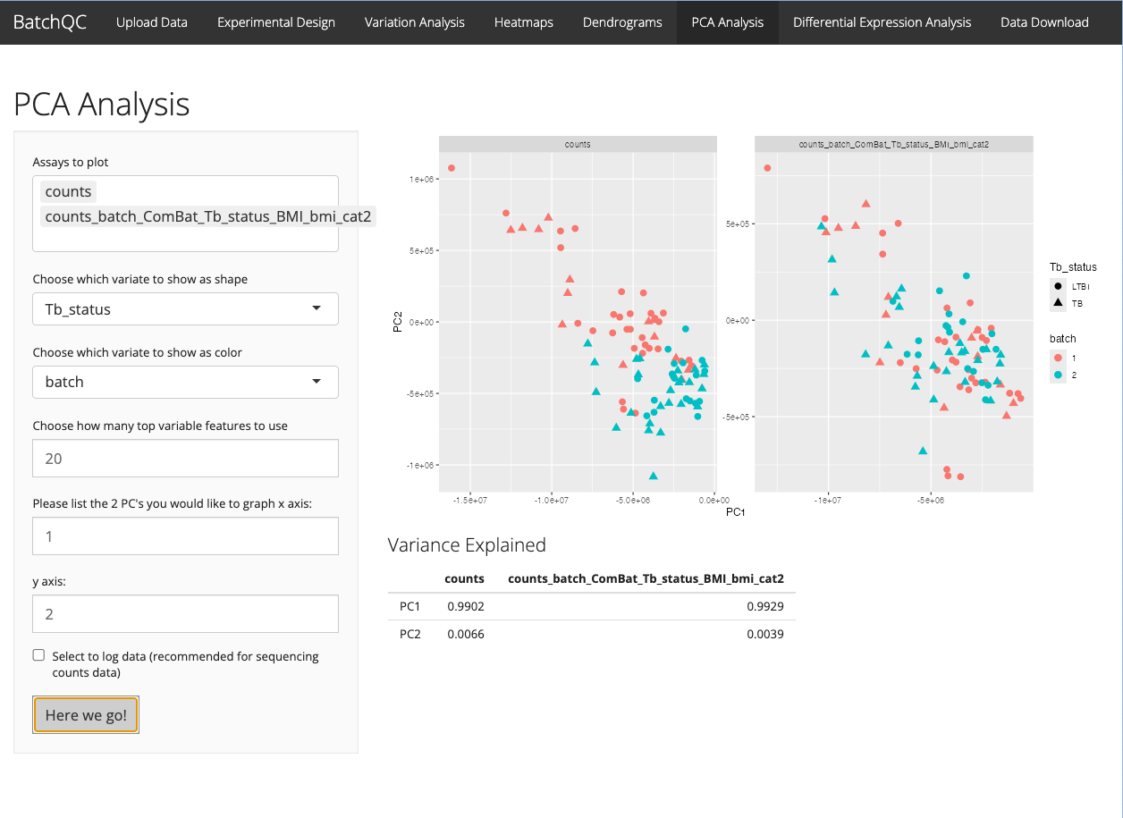

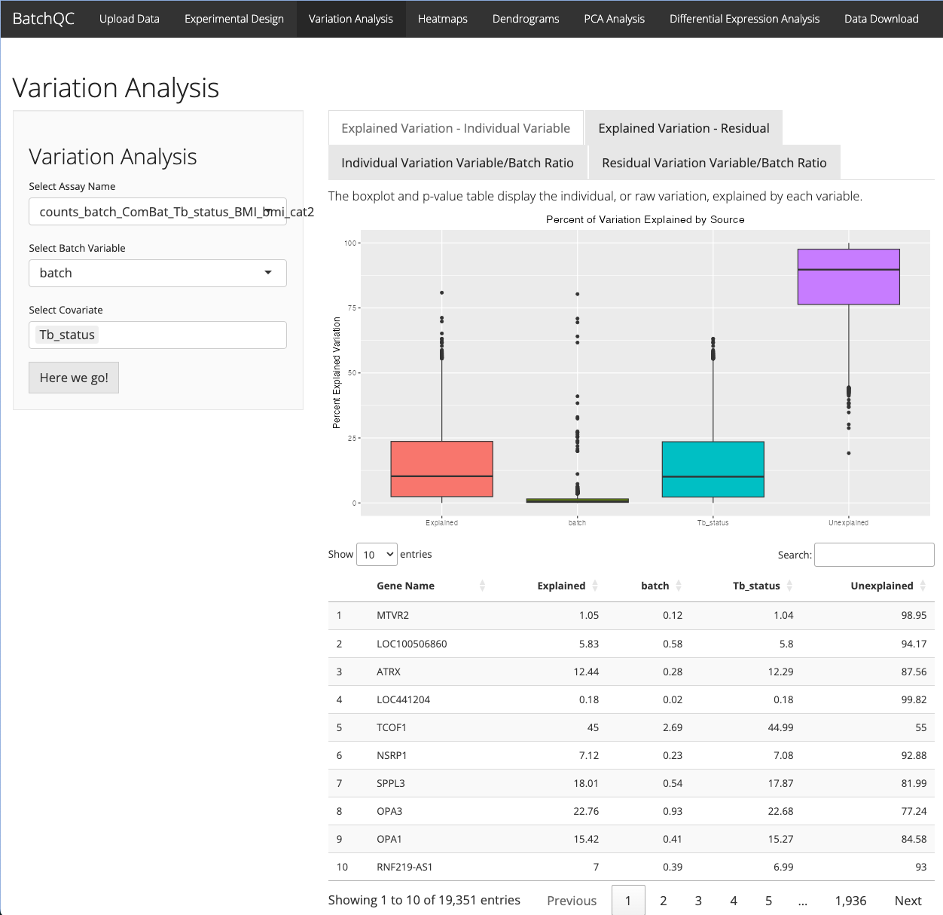
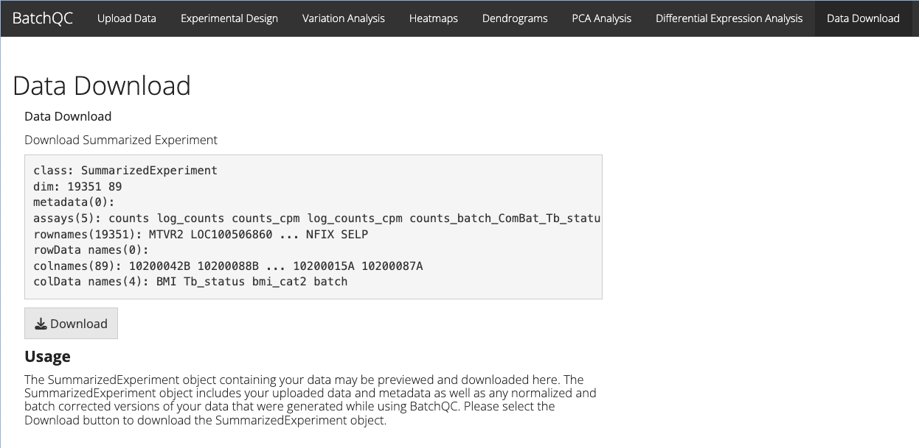
BatchQC: Evaluating Batch Effects
Test for Negative Binomial Assumption
Apply multiple batch correction methods (including ComBat-Seq)
Evaluate need for batch
Interactive Visualizations
Compare original and batch corrected data side by side
Export corrected data
Shiny App or R functions
Jessica McClintock
Solaiappan Manimaran

Slide 15
The TBSignatureProfiler
R Package for profiling 70+ published signatures
Signatures of disease, response, and progression
Scoring with original models (new!) and gene set enrichment methods:
GSVA, ssGSEA, PLAGE, singscore, zscore, and ASSIGN
Visualization tools and functions:
Annotated heatmaps, boxplots, ROC, p-value and AUC tables
NEW! TBSignatureProfiler graphical interface
Brie Odom
David Jenkins
Johnson et al, BMC Infectious Diseases, 2020; https://github.com/compbiomed/TBSignatureProfiler

Slide 16
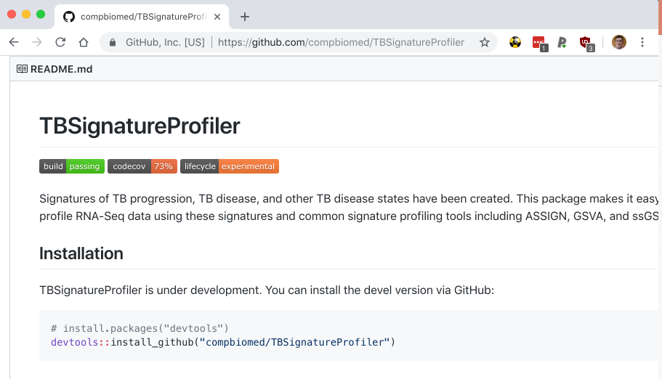
The TBSignatureProfiler

Slide 17

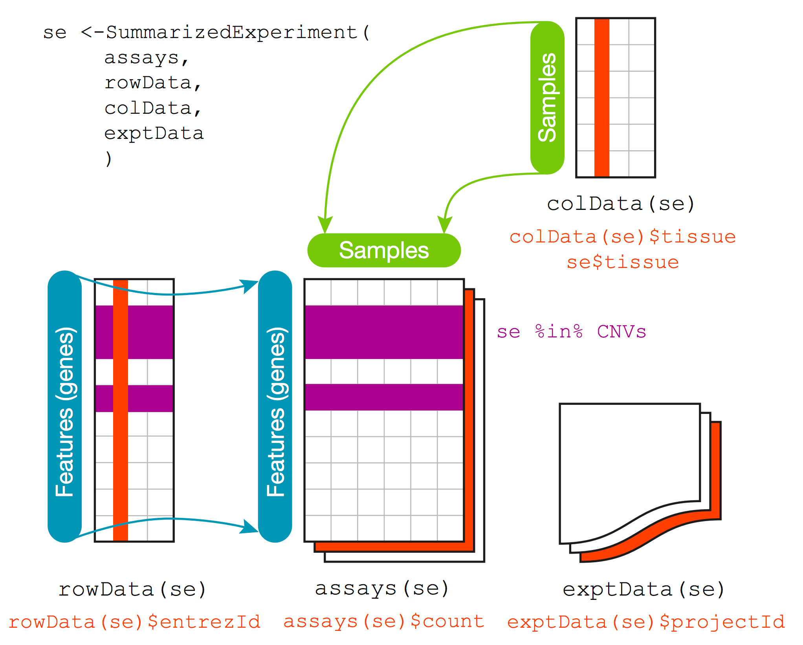
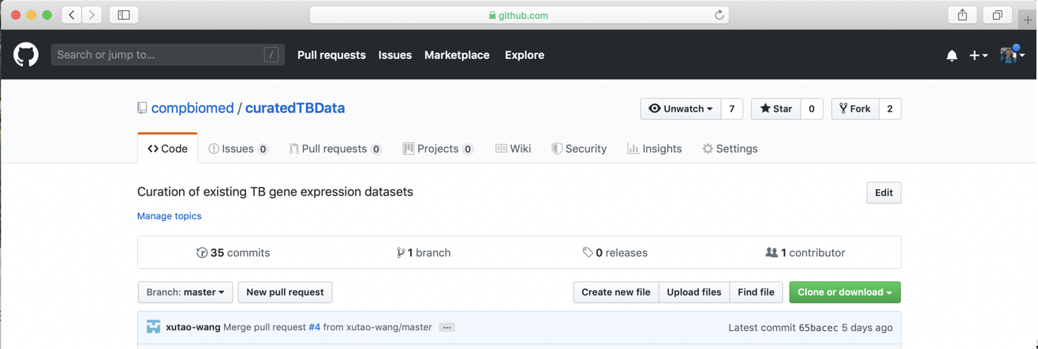
The curatedTBData Project
Curate expression data: currently 42+ TB experiments—more than 4,000 samples!
Multiple platforms (array, sequencing, etc)
Using SummarizedExperiment Objects in R
Resource for biomarker validation/development!
Dr. Prasad Patil
Xutao Wang
https://github.com/compbiomed/curatedTBData

Slide 18
curatedTBData and TBSignatureProfiler

Slide 19
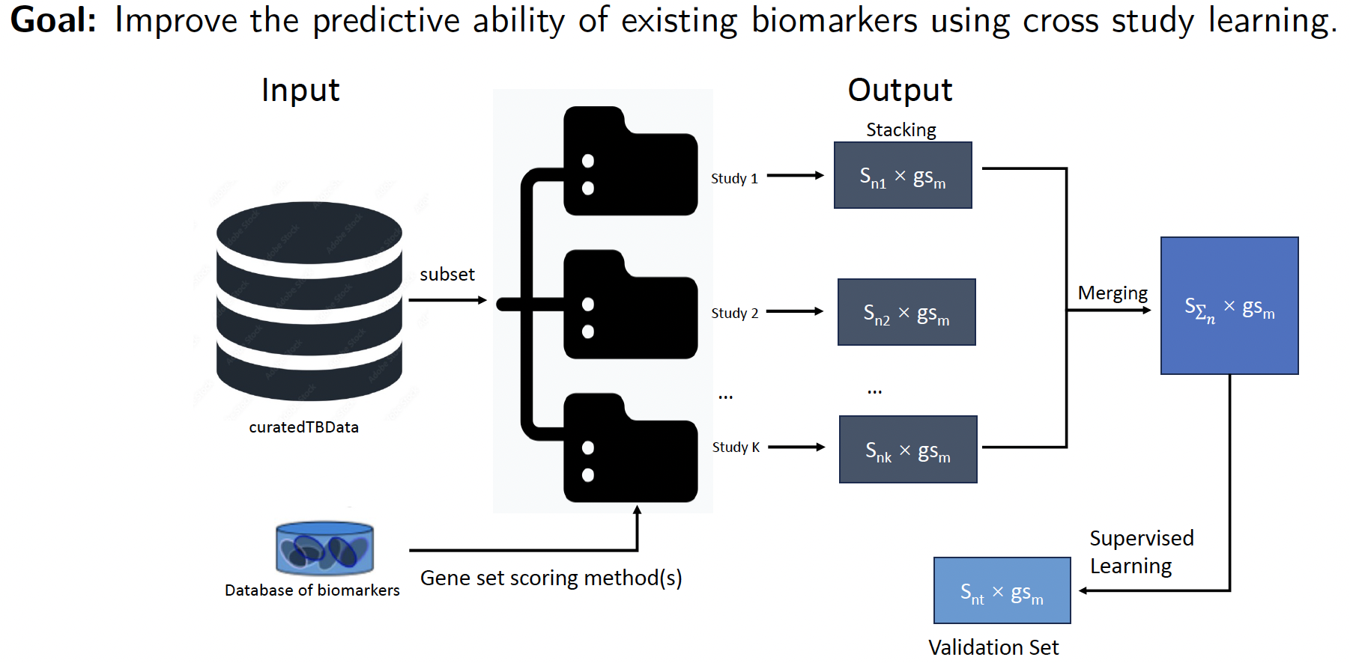
Multi-study Learning

Slide 20
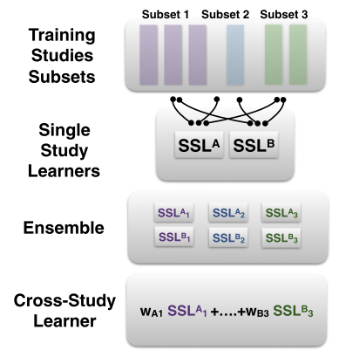
Solution when multiple studies available: ensemble learning
Ensemble learning:
Established machine learning approach
Combined multiple models to improve prediction
Cross-study learners (CSL)
Generalizable performance in independent test set
Experimental and theoretical insights (regression)
Cross-study learners from Patil and Parmigiani, “Training replicable predictors in multiple studies”, PNAS 2018
Notes:
The presence of heterogeneity makes it challenging to develop models
Recently, there has been a solution proposed when use multiple studies with the same purpose, that is to use ensemble learning
In this recent paper in PNAS, they bring it to deal with heterogeneity.

Slide 21
Intuition
VS
Merging
Ensembling
Integrates data
Remove undesired variation from as many of the genomic features as feasible, then use the "cleaned" data in training
Integrates models
Weights reward prediction functions that, while trained in one batch, continue to predict well in other batches
likely to avoid using features affected by batch effect

Slide 22
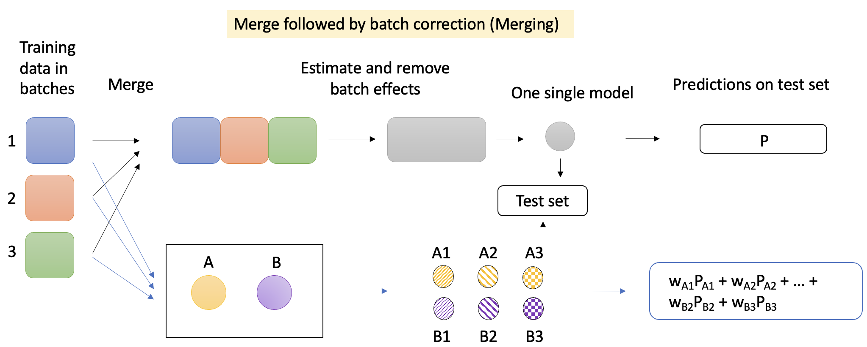
Should we Merge or Ensemble?

Slide 23
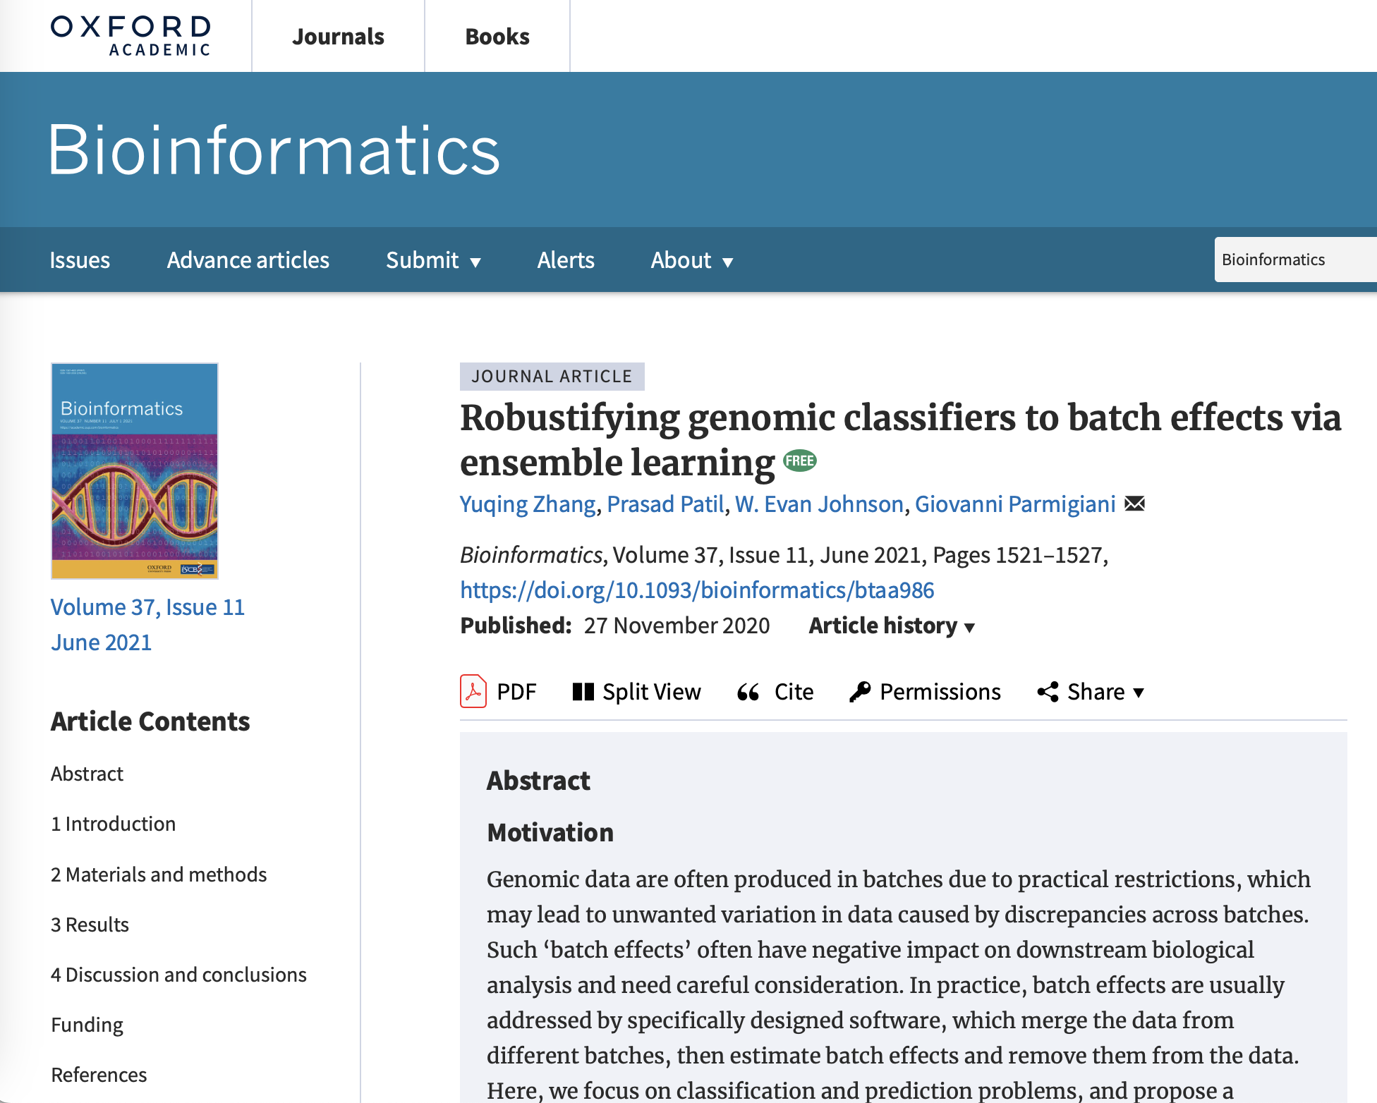

Yuqing Zhang
Prasad Patil
Giovanni Parmigiani

Slide 24
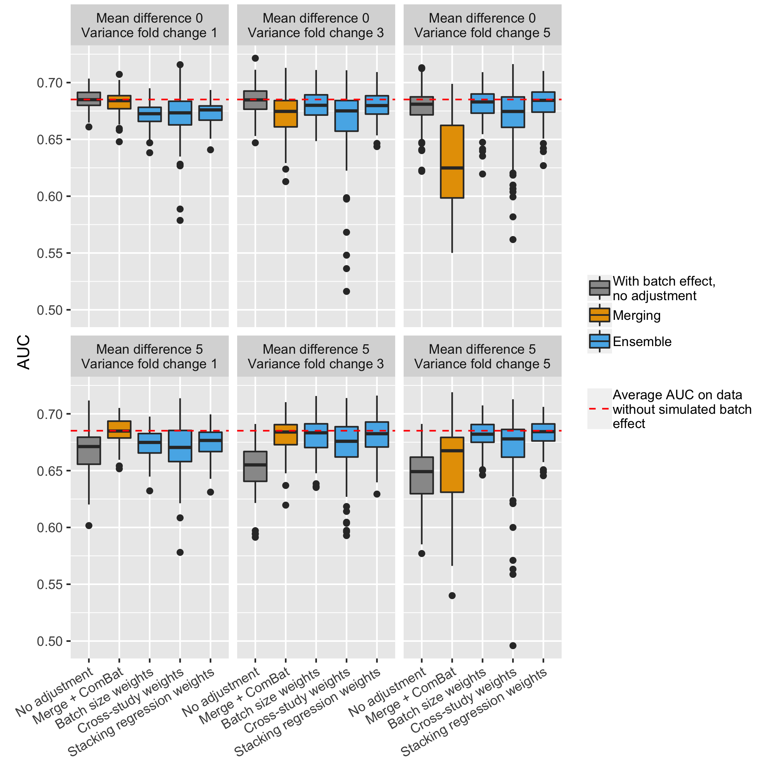
Example results using random forest (RF) as learner
Transition point: merging out-performs ensemble at low level of batch effect; ensemble is better at high batch differences
Consistent with established cross-study results
Zhang, et al. "Robustifying genomic classifiers to batch effects via ensemble learning." Bioinformatics., 2021

Slide 25
Multi-Source Domain Adaptation
Traditional models:
Training and testing datasets are distributed identically. Violated by:
covariate shift
distribution gap
Multi-study learning
Common for multiple datasets with shared covariates and outcomes:
Inefficient to rely on one data source for training
Multi-source domain adaptation:
Merge all training studies
Keep each training dataset separately
Dr. Prasad Patil
Xutao Wang

Slide 26
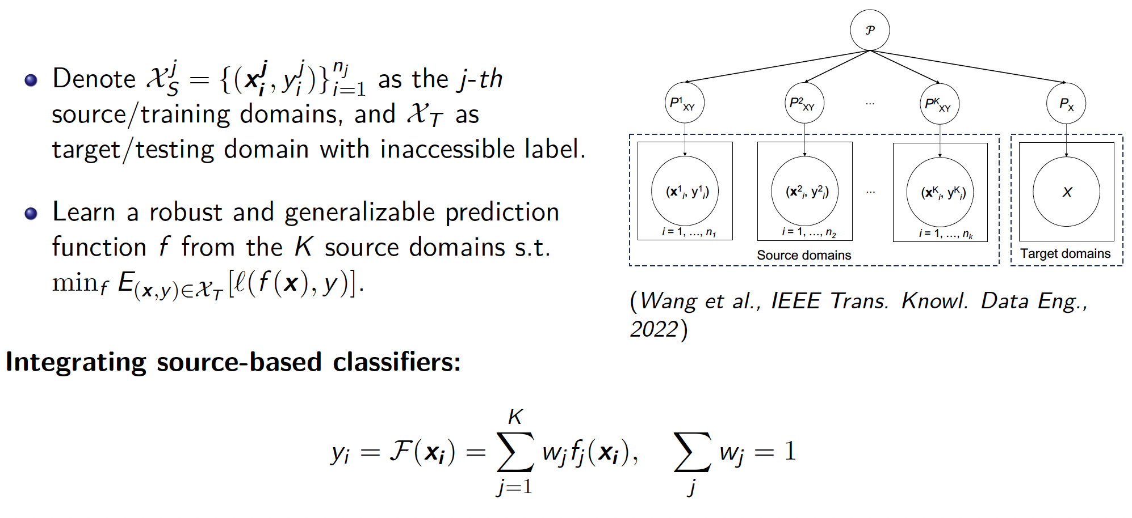
Multi-Source Domain Adaptation

Slide 27
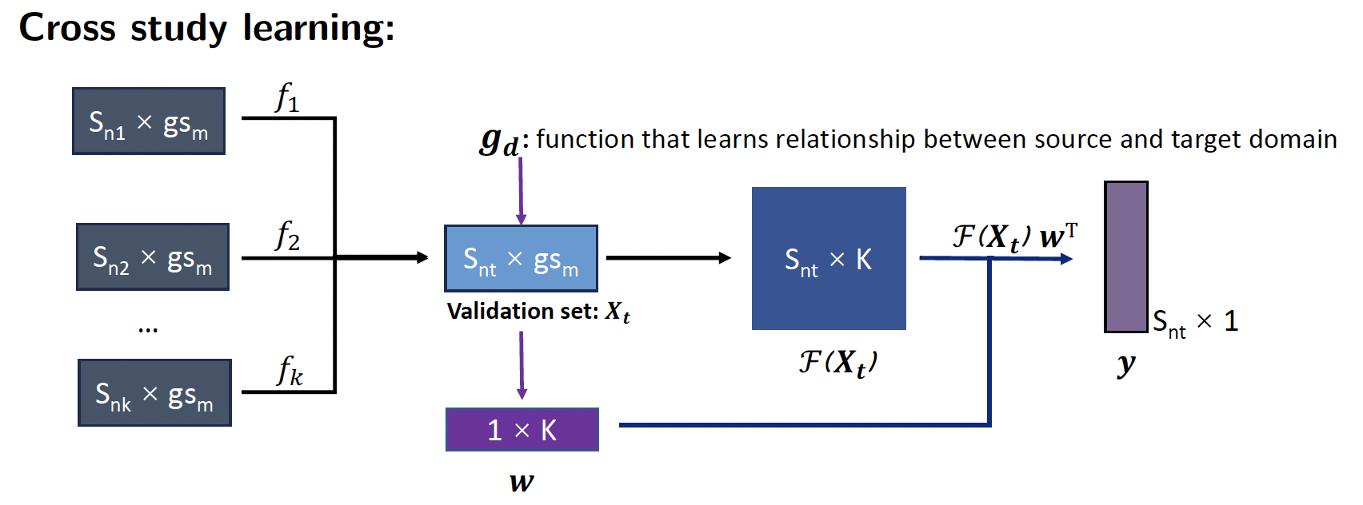
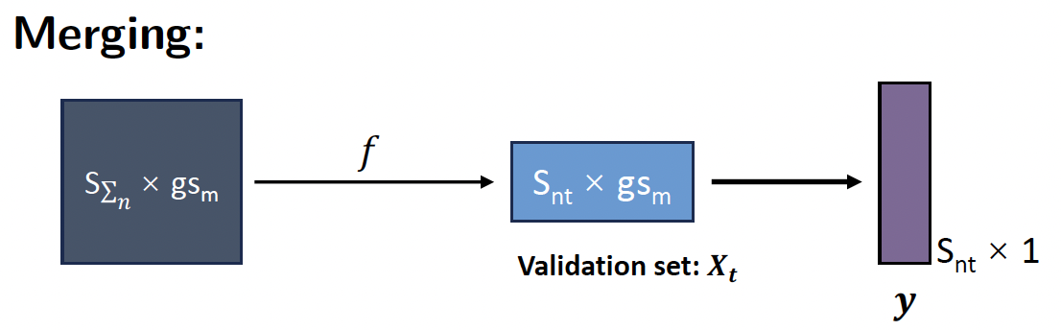
Multi-Source Domain Adaptation
Dr. Prasad Patil
Xutao Wang

Slide 28
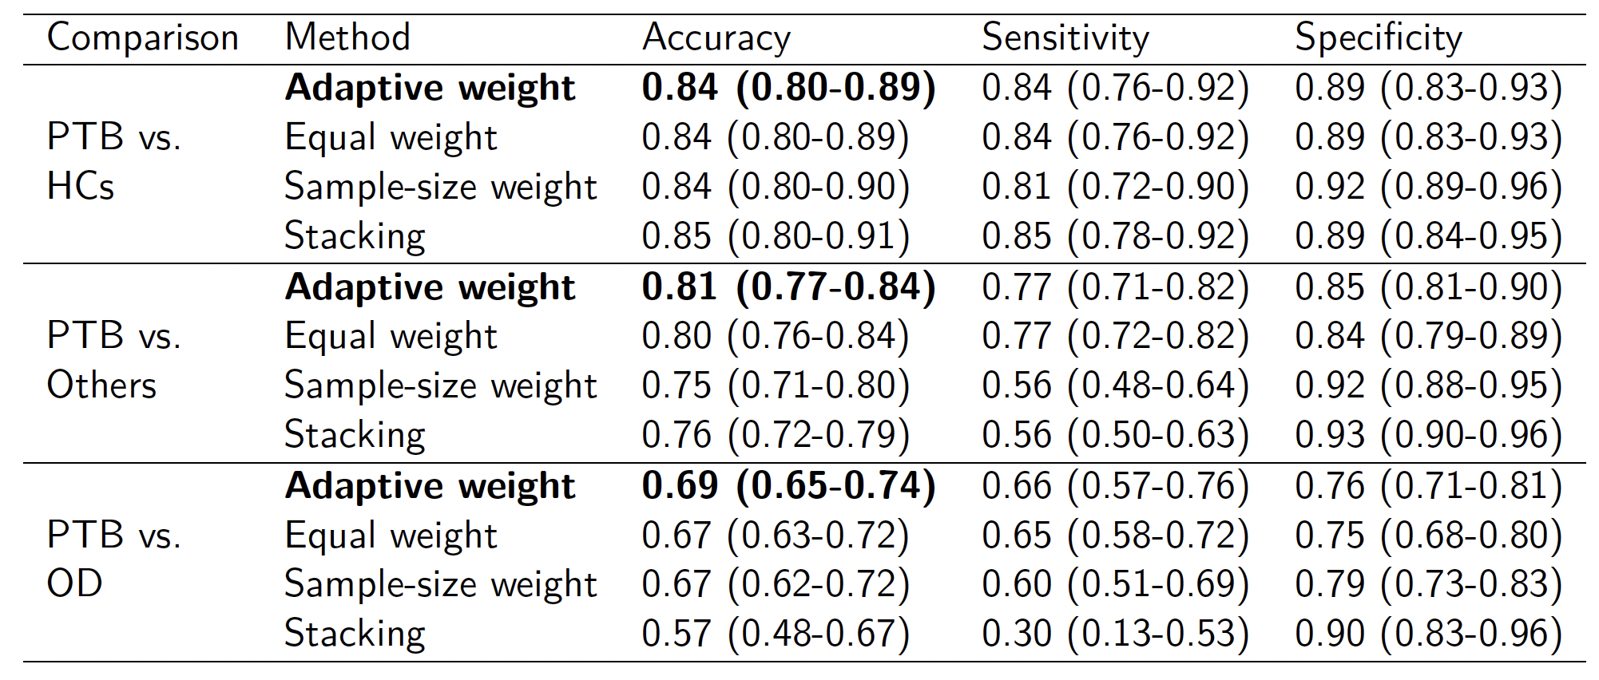
Adaptive Learning Improves Prediction

Slide 29
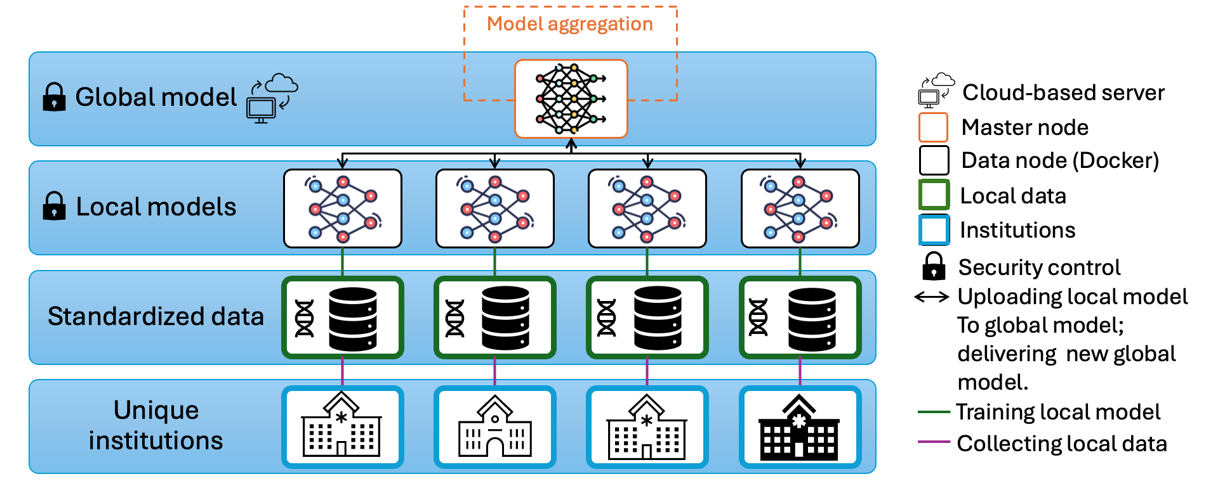
Federated Learning: Architecture

Slide 30
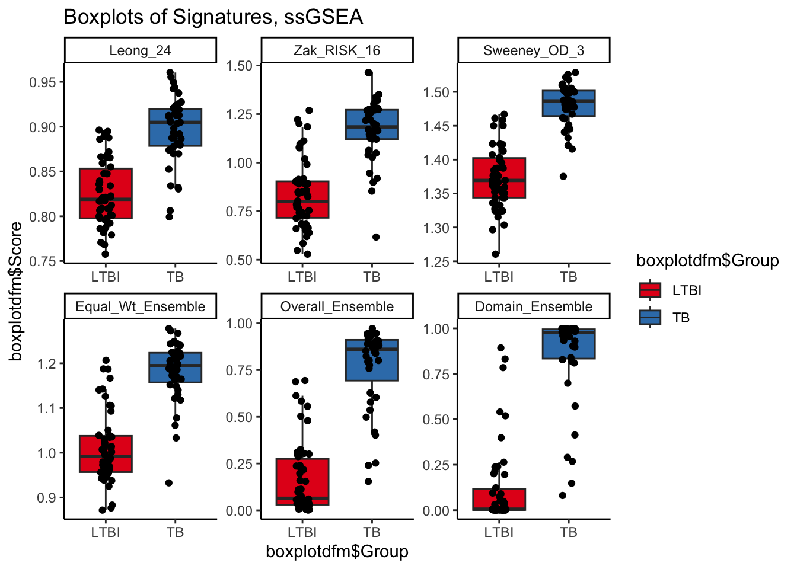
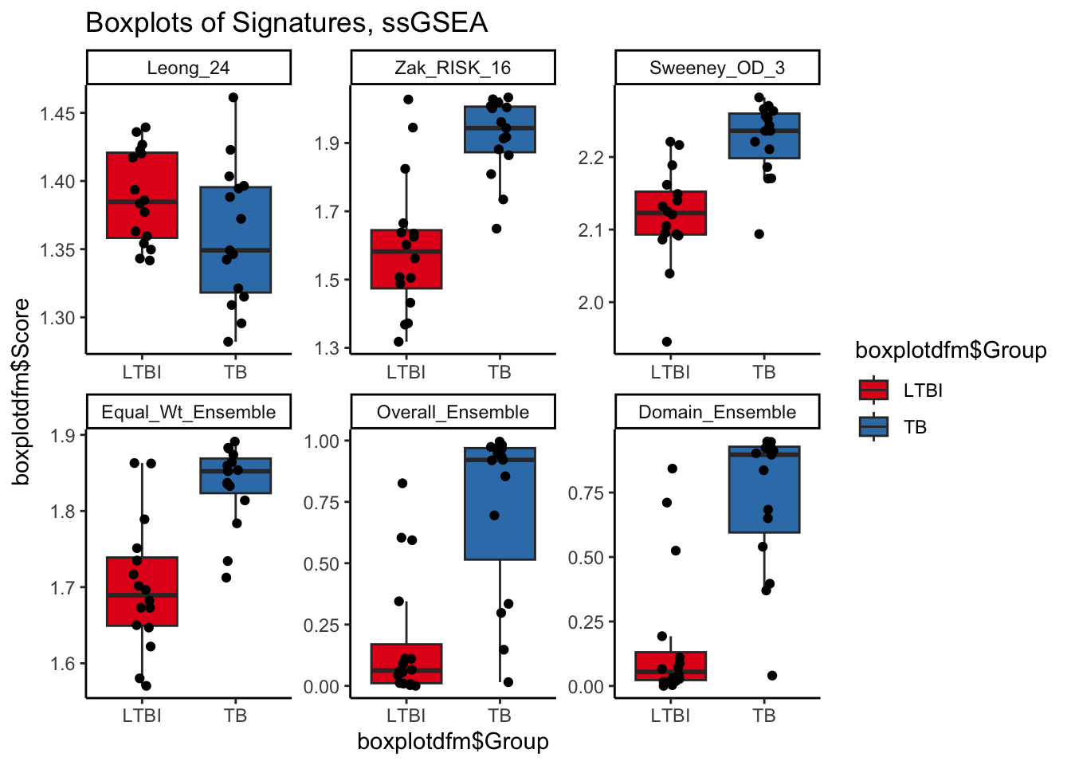
Indian Dataset
Ugandan Dataset
Country | Equal Weights | Ensemble Weights | Domain Weights
India | 0.93 | 0.96 | 0.97
Africa | 0.88 | 0.90 | 0.91
Howard Fan

Slide 31


Thank you!
https://www.wejlab.org

